Slide 1


Kingswood
Dearne Valley Yorkshire | Outdoor Education | Kingswood
27.04.22

Slide 2
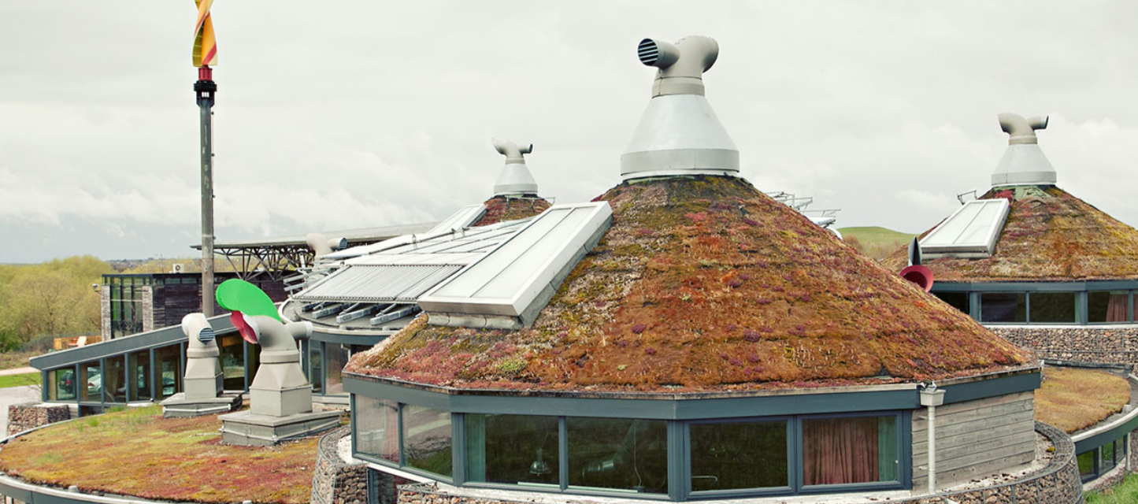
The centre

Slide 3
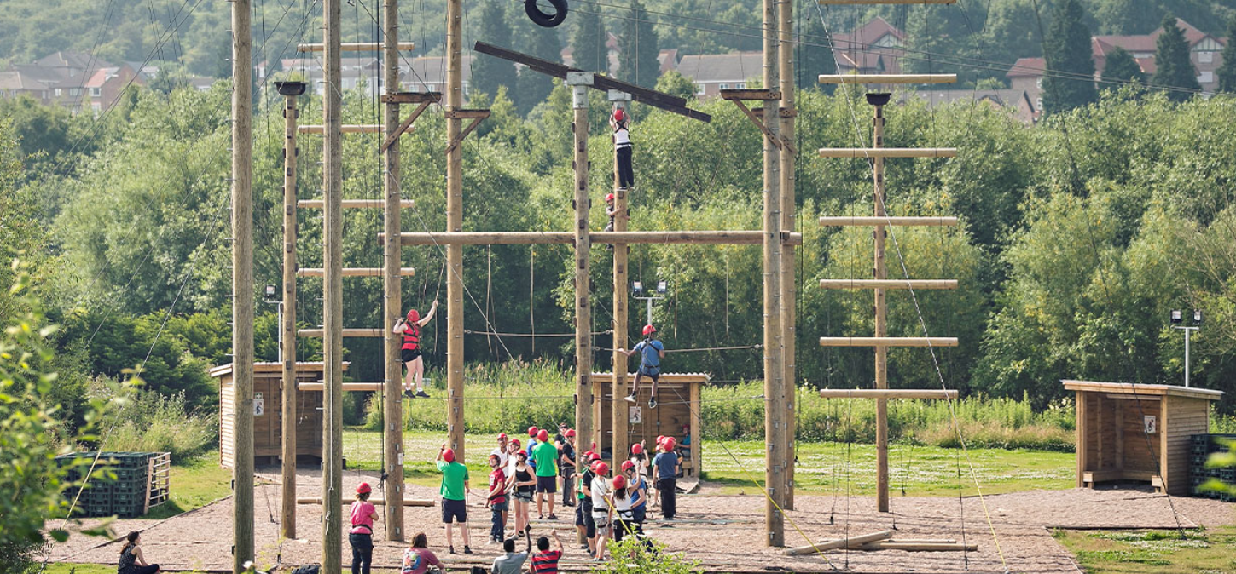
The centre

Slide 4
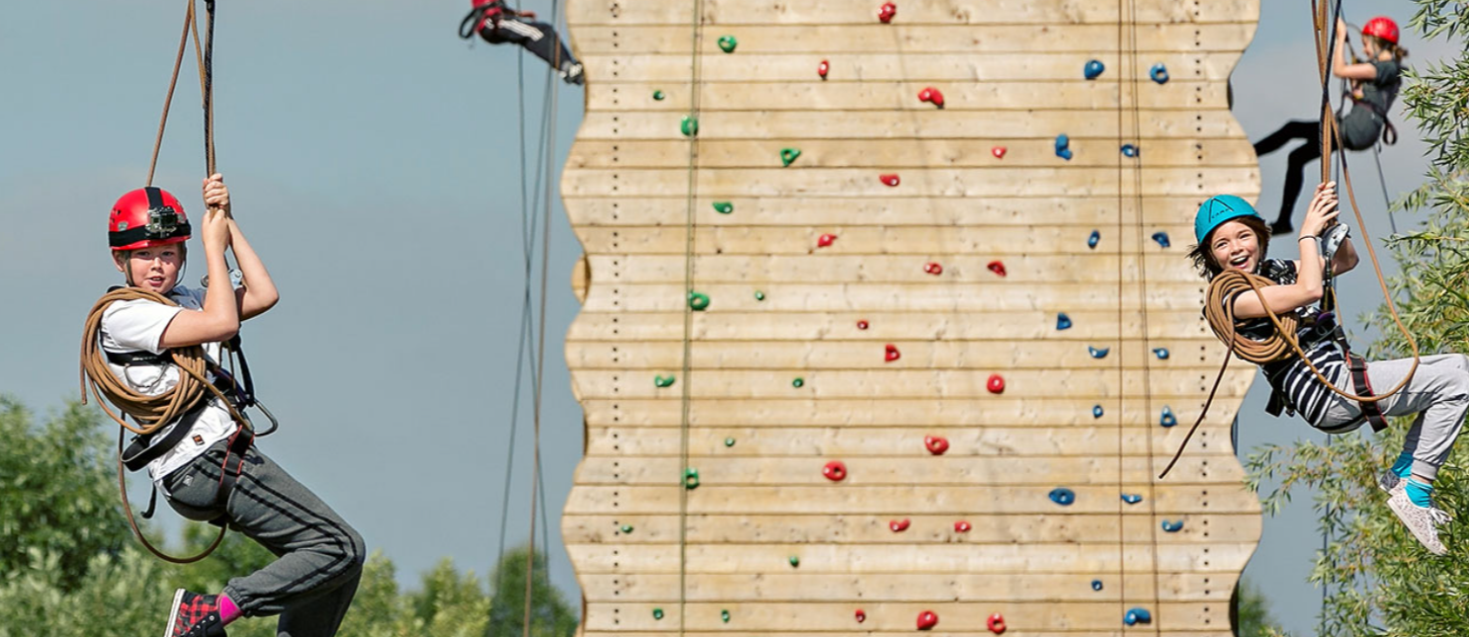
The centre

Slide 5
The activities

Slide 6
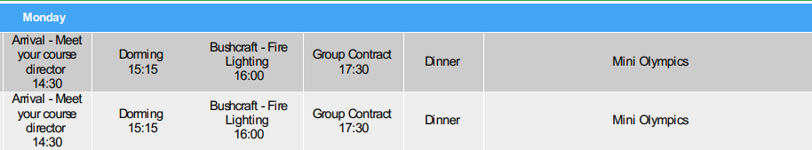

Slide 7
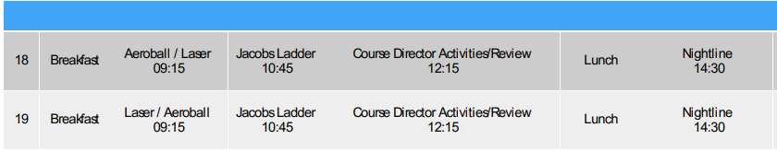
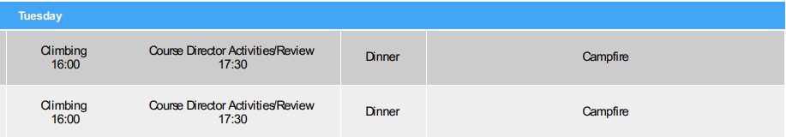

Slide 8
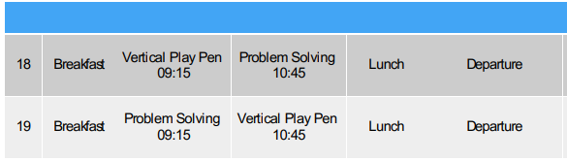

Slide 9
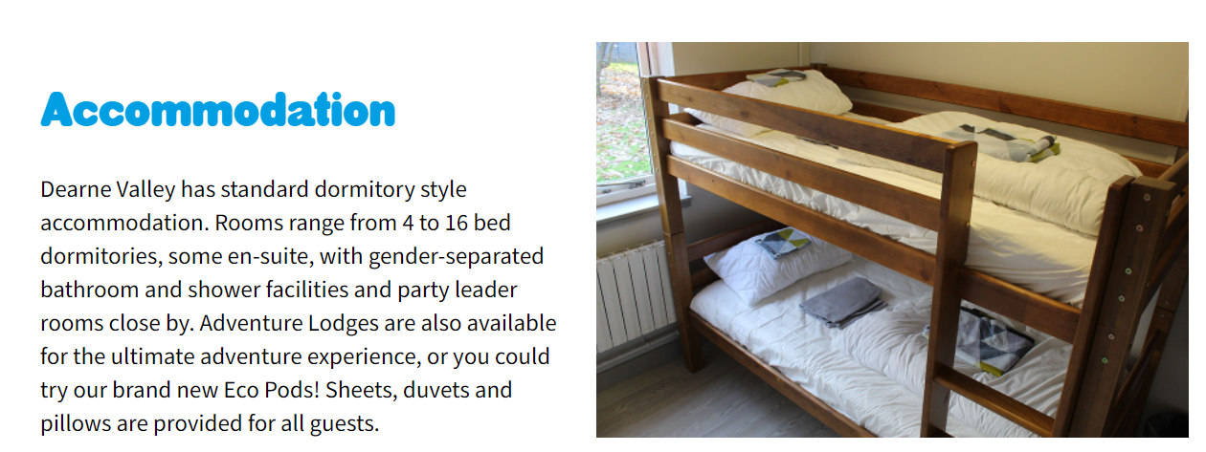
The accommodation

Slide 10
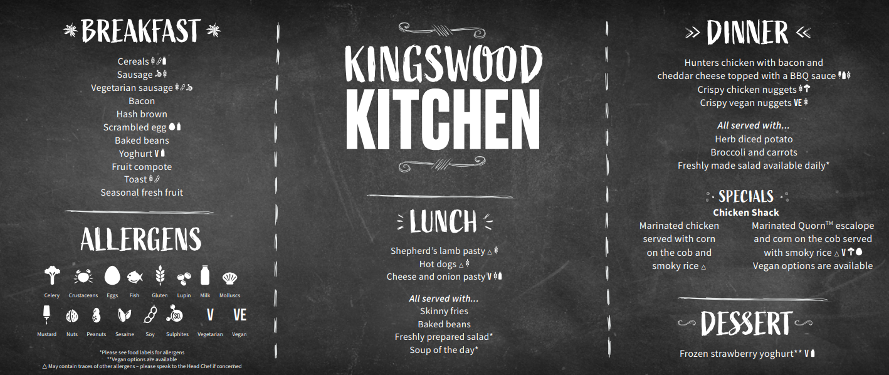

Slide 11
Things to take
Clothes list – please ensure names are in your child’s clothing.
Money – at most £15 to be spend at the onsite gift shop.

Slide 12
Things not to take
New and expensive things
Electrical items

Slide 13
The school website will have a blog where we will upload photos and give you a chance to post some messages.

Slide 14
Travel times
All within school hours

Slide 15
Medical information – please speak to a member of staff about any needs of a medical or sensitive nature. Any medication needs to be clearly labelled.

Slide 16
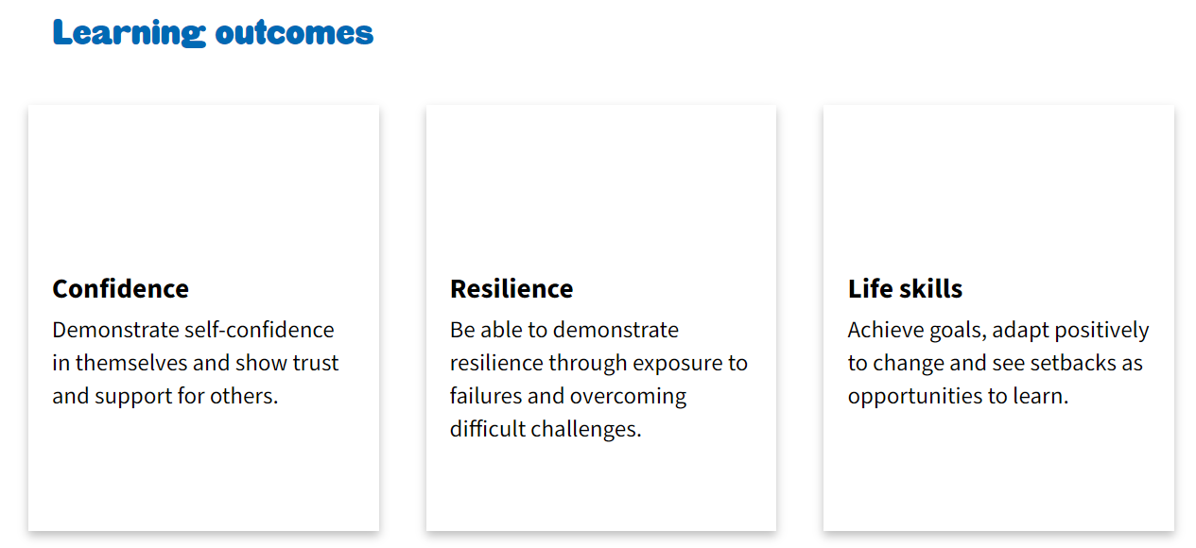
Learning goals

